Slide 1

Session 8
Black Box Testing (2)
Equivalence Partitioning
chengbaolei@suda.edu.cn

Slide 2

Black Box Testing Techniques
• Boundary Value Analysis
• Equivalence Partitioning
• Decision Table
• Cause-effect Graph
• Combinatorial Test

Slide 3
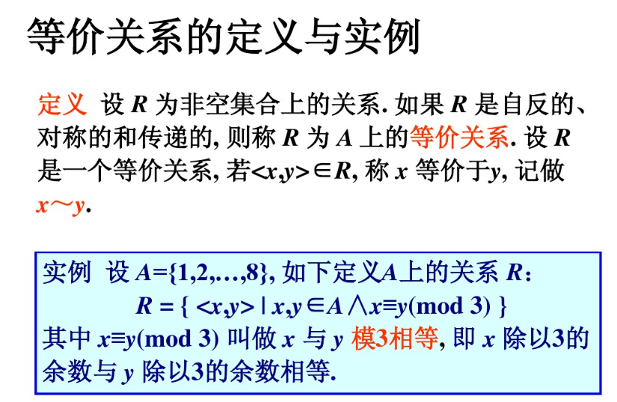

Slide 4
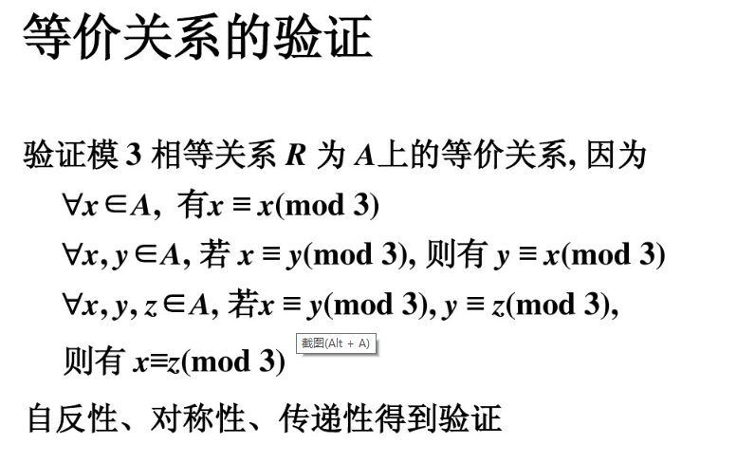

Slide 5
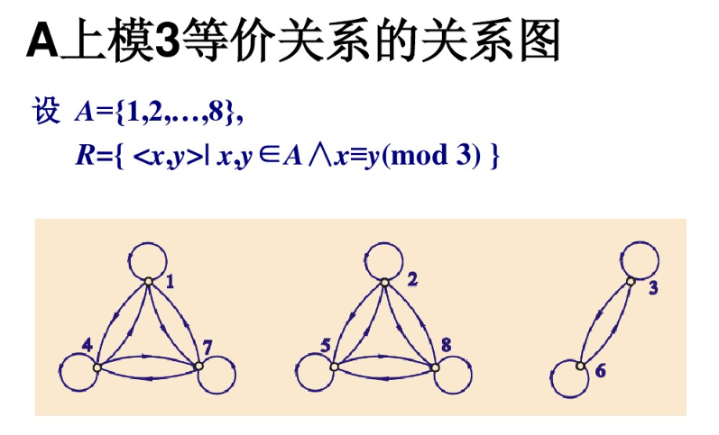

Slide 6
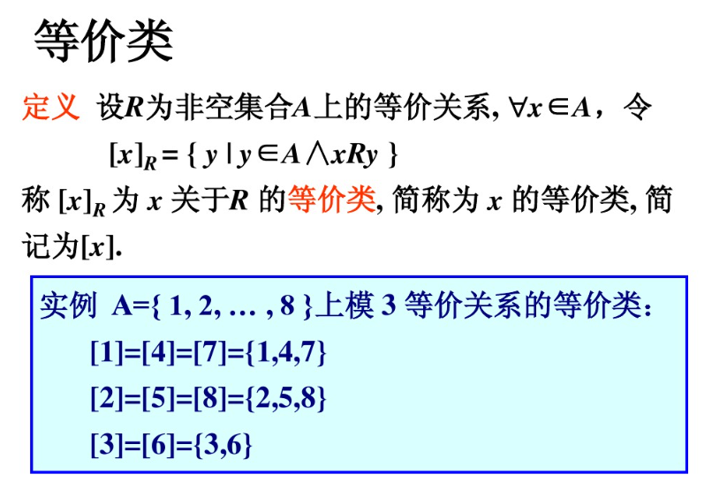

Slide 7
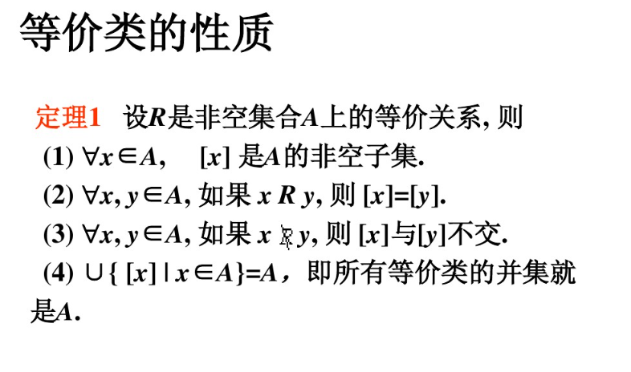

Slide 8
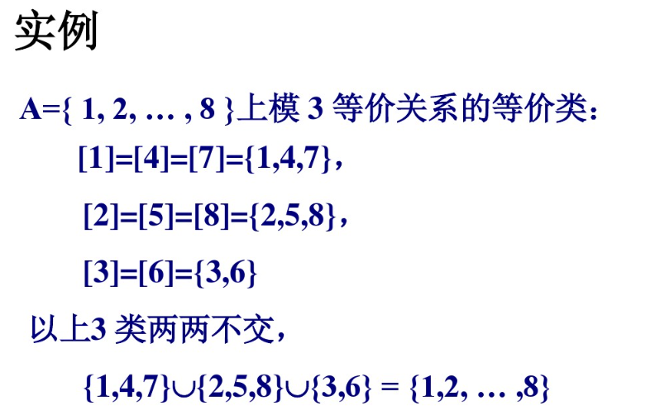

Slide 9
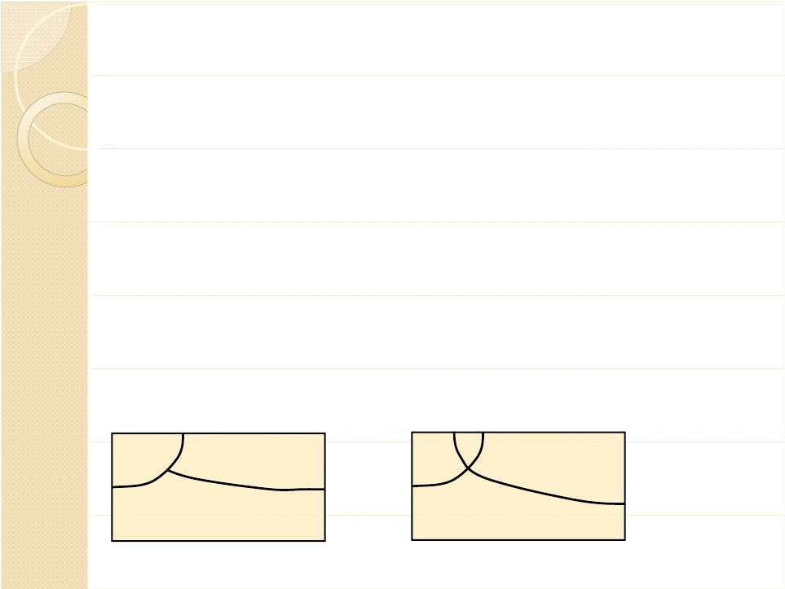
Equivalence Class
The ECs should partition the input domain (the set
of all possible input to the program)
1.
2.
The ECs should be pairwise disjoint (no
overlapping to reduce redundancy in testing)
Together the ECs should cover the domain (to
ensure the completeness of testing)
b1,b2
b1
b2
b3
A partition of D
b1
b2
b3
Not a partition
Completeness?

Slide 10

Equivalence Partitioning
Equivalence partitioning allows a tester to
subdivide the input into a number of
equivalence classes (EC).
Each EC defines a set of input such that it is
likely to be handled by the system in the
same way.
The tester select one test case from each
equivalence class.

Slide 11

Motivation
Equivalence Class:
If one test case in an EC detects a defects,
all other test cases in the same EC are
likely to detect the same defect
If one test case in an EC does not detect a
defect,no other test cases in the same EC
is likely to detect the defect.

Slide 12

Example: sum of two integers
Consider a program which adds two
integers a and b.
Consider the following set of ECs:
V1={(a,b):a>0}
V2={(a,b):b>0}
V3={(a,b):a<0}
V4={(a,b):b<0}
Does the ECs partition the input domain?

Slide 13

Improved formulation
VA1={a: a>0}
VA2={a: a=0}
VA3={a: a<0}
VB1={(b: b>0}
VB2={(b: b=0}
VB3={(b: b<0}

Slide 14

Steps of EC partitioningTesting
1.Identify the input/output parameters
Parameters to a method, data read from file, global variable
2.Identify characteristics for the input/output parameters
e.g. range of input variables, relationship among variables
3.Each characteristic is partitioned into Equivalence Classes
4.Select a strategy for combinations of equivalence class for different
characteristics
e.g.strong vs weak testing
5.Identify infeasible combinations of equivalence classes
6.Test Case Generation
For each feasible EC, generate one test case to cover the EC

Slide 15
Example: Interest Rate
A savings account in a bank earns a different rate of
interest depending on the balance in the account.
If a balance is in the range $0 up to $100 has a
3% interest rate,a balance over $100 and up to
$1000 has a 5% interest rate,and balances of
$1000 and over have a 7% interest rate.
Write a program which inputs the account balance
and outputs the amount of interest for a year.

Slide 16

Step1.Identify the input parameters
We only have one variable: account balance
Step2.Identify characteristics for
the input parameters
For the account balance parameter, we create
partitions based on the range of account balance

Slide 17

Step3.Each characteristic is
partitioned into Equivalence Classes
The following partitions are identified:
Valid Partitions:
VP1: 0<=balance<=100
VP2: 100<balance<1000
VP3: balance>=1000
Invalid Partition:
IP1: balance<0
Does the ECs partition the input domain?

Slide 18
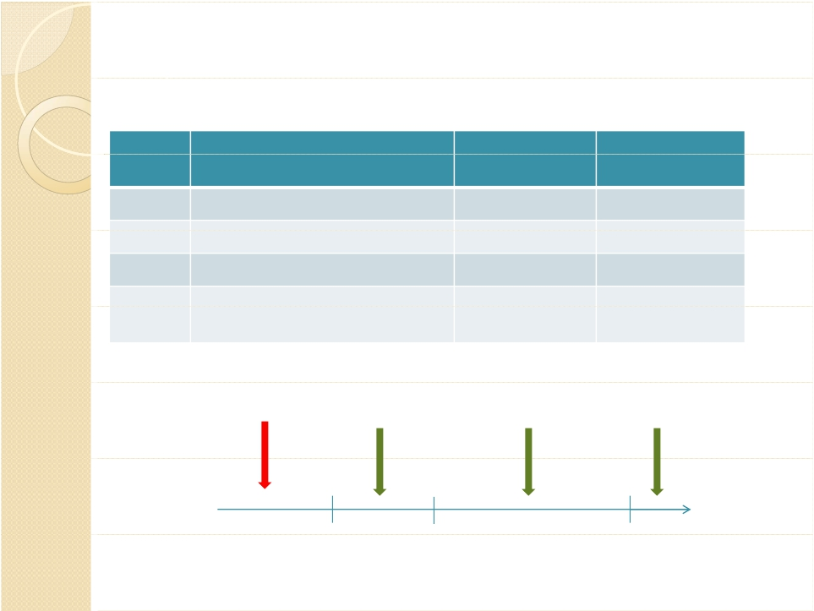
Step 4:Test Case Generation
Test Case | EC | Input | Expected output
TC1 | {balance: 0<=balance<=100} | Balance=50 | $1.5
TC2 | {balance: 100<balance<1000} | Balance=400 | $20
TC3 | {balance: balance>=1000} | Balance=1500 | $105
TC4 | {balance :balance<0} | Balance=-10 | Invalid input
Invalid partition
e.g. -10
Valid partitionV1 Valid partitionV2
e.g. 50 e.g. 400
Valid partitionV3
e.g. 1500
0
100
1000
3%
5%
7%

Slide 19
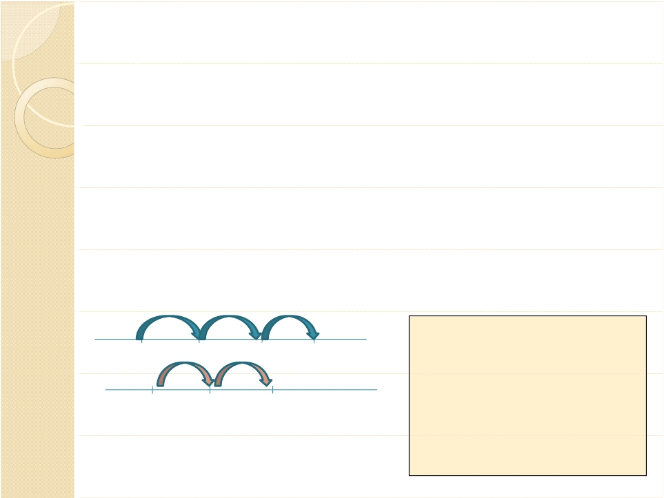
Equivalence Partitioning for multiple
variables/characteristics
Consider a function f which accepts two integers x and y.
a<=X<=d with intervals [a,b),[b,c),[c,d]
e<=Y<=g with intervals [e,f),[f,g]
X1
X2
X3
VX1={x: a<=x<b}
a
b
c
d
X
VX2={x: b<=x<c}
Y1
Y2
VX3={x: c<=x<=d}
e
f
g
Y
VY1={x: e<=x<f}
VY2={x: f<=x<=g}

Slide 20
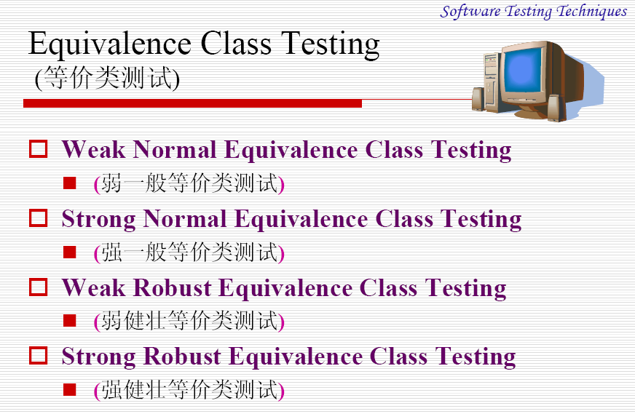
Hybrid approach

Slide 21
Approach for test case selection
Strong ECTesting:
A test case is selected for each element in the set
of Cartesian Product of the input
variables/characteristics
e.g.ECx × ECy
={(x1,y1),(x1,y2),(x2,y1),(x2,y2),(x3,y1),(x3,y2)}
Weak ECTesting:
A value from each EC appears in at least one test
case.Values of different input variables/ characteristics are chosen independent.

Slide 22
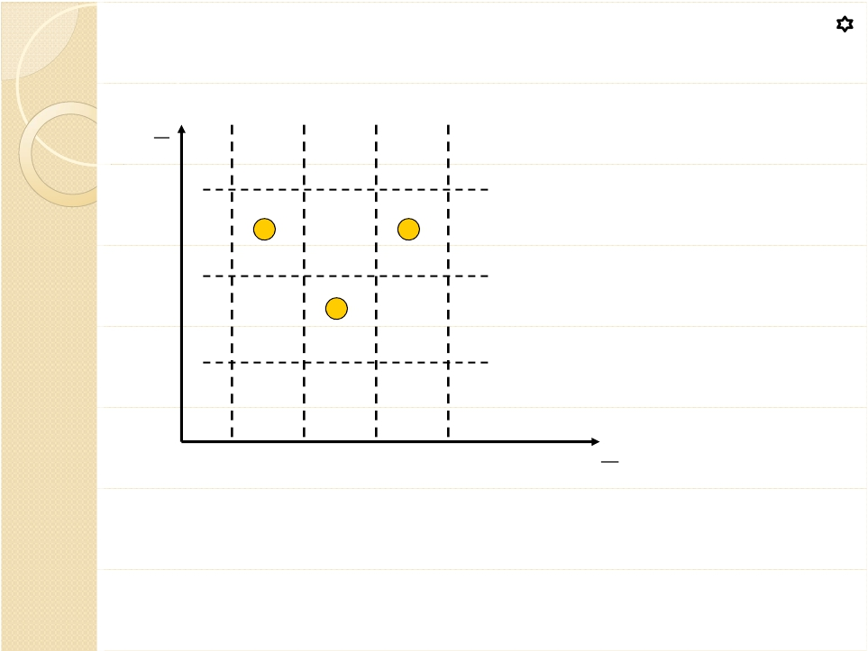
Weak Normal Equivalence Testing
Y
g
f
e
Using one variable from each equivalence class (interval) in a test case.
0
X
a
b
c
d
Useful when the variables/characteristics are independent:
If there is fault with handling a certain value xi∈X,we can
produce a failure by testing X independent of Y (with any
valid value of yi ∈Y).

Slide 23

Interaction Fault
An interaction fault is triggered when a certain combinations of
t>=1 input value causes the program containing the fault to
enter an invalid state,which propagate to a point where it is
observable and reveal the fault
Simple Fault (t=1)
A fault can be triggered by some value of an input variable,
regardless of the value of other input variables.
Pair-wise interaction fault (t=2)
A fault can be triggered only when two input variables are set
to specific value
The definition can be generalized to a t-way interaction fault,
where t>=2.

Slide 24
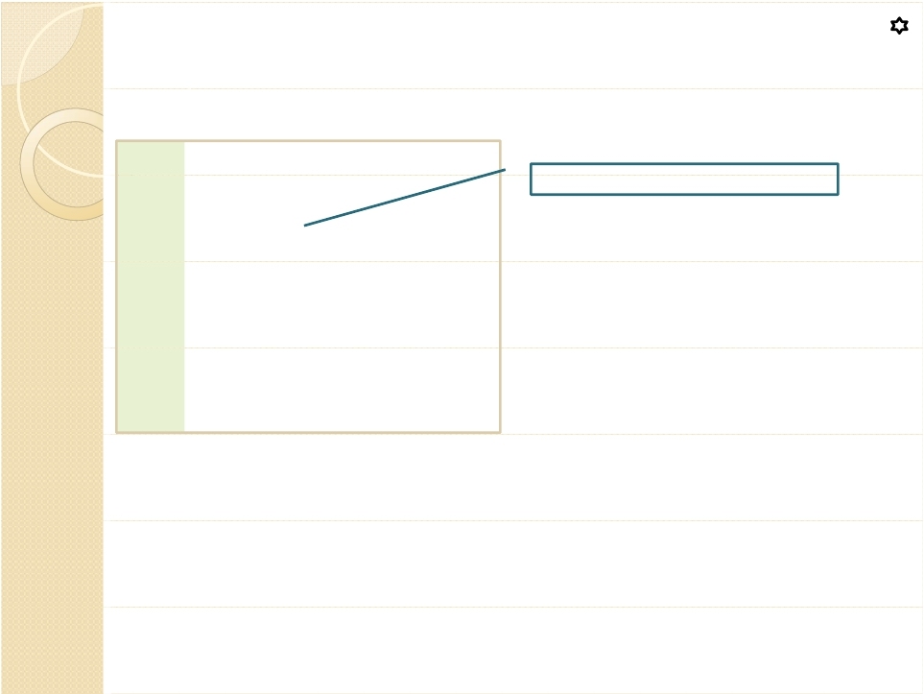
Interaction fault:example 1
1
2
3
4
5
6
int x, y;
input(x,y);
if (x>=0)
output (2*y);
else
output (3*y);
Should be x + 1>=0
Assume x,y ∈ {-2,-1,1,2}
7
What test case should be used to reveal the fault?
Should strong or weak testing be used to detect
the fault?

Slide 25

Interaction fault:example 1
1
2
3
4
5
6
int x, y;
input(x,y);
if (x>=0)
output (2*y);
else
output (3*y);
Should be x + 1>=0
Assume x,y ∈ {-2,-1,1,2}
7
The fault is revealed when x = -1 with any value of y. This is
an example of simple fault.
To detect the presence of a simple fault in x, we just need
to test the different values of x with any value of y. Weak
testing is sufficient.

Slide 26
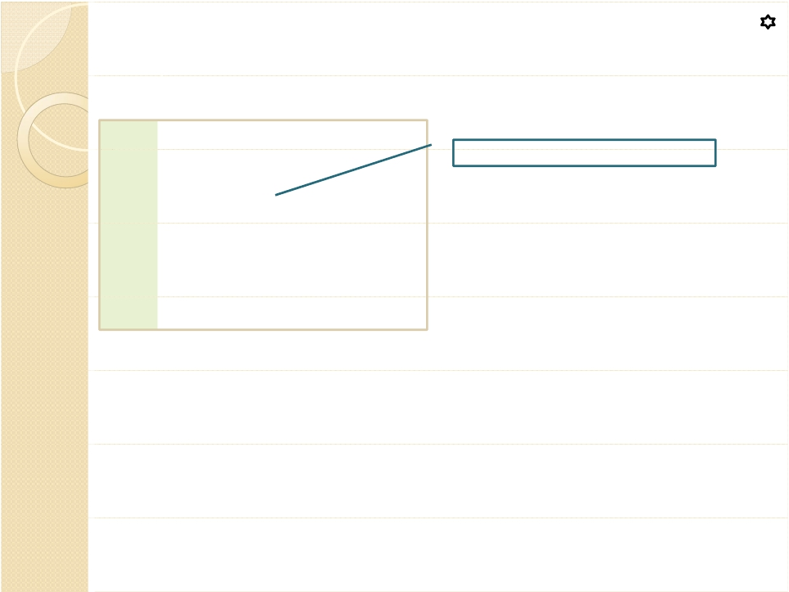
Interaction fault:example 2
1
2
3
4
5
6
int x, y;
input(x,y);
if (x && y)
output(f(x,y));
else
output (g(x,y));
Should be x || y
Assume x,y ∈ {T,F}
What test case should be used to reveal the fault?
Should strong or weak testing be used to detect
the fault?

Slide 27
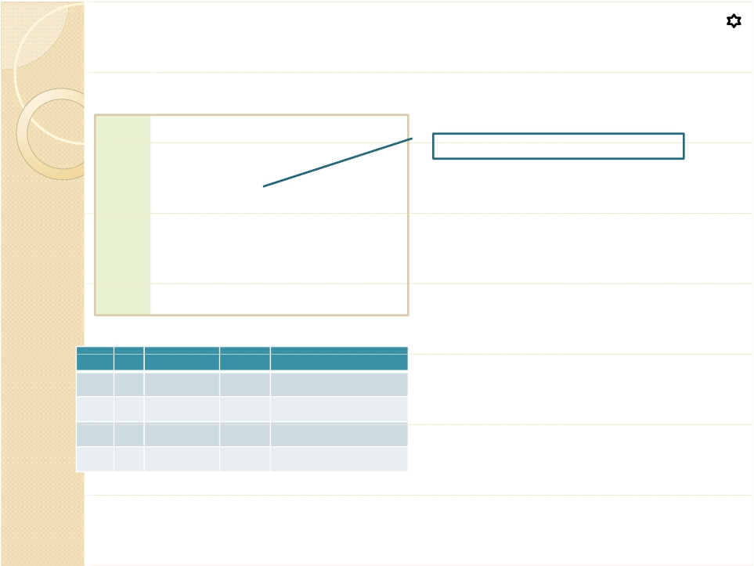
Interaction fault:example 2
1
2
3
4
5
6
int x, y;
input(x,y);
if (x && y)
output(f(x,y));
else
output (g(x,y));
Should be x || y
Assume x∈ {T,F} ,y ∈ {T,F}
When x is true,the fault can only be
detected when y is false (but not
when y is true). Weak testing may
not be able to reveal the fault (if the
inappropriate value for y is chosen).
This is an example of pair-wise interaction fault.
x | y | x&&y | x||y | Detect the fault?
T | T | T | T | No
T | F | F | T | Yes
F | T | F | T | Yes
F | F | F | F | No

Slide 28

Strong Normal Equivalence Testing
Y
g
f
e
0
X
correct
a
b
c
d
Useful when the variables/characteristics
may interact and some faults can only be
revealed when certain combinations of
values of X and Y appears together.

Slide 29

Limitations of Strong Testing
May generate many test cases,some of
which may be impossible,redundant,not
interesting.
Example: consider the NextDate example
31 June, 30 Feb…
Consider the feasible combinations.

Slide 30
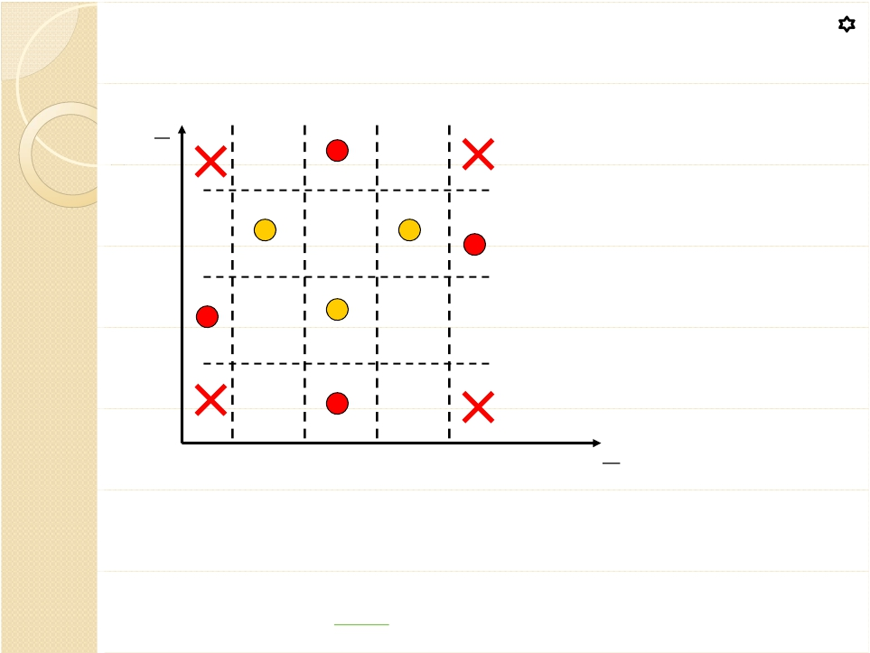
Weak Robust EquivalenceTesting
Y
g
f
e
0
X
a
b
c
d
1. For valid inputs, use one value from each valid class (weak normal equivalence class).
2. For invalid inputs, a test case will have one invalid value and the remaining values will all be valid.

Slide 31
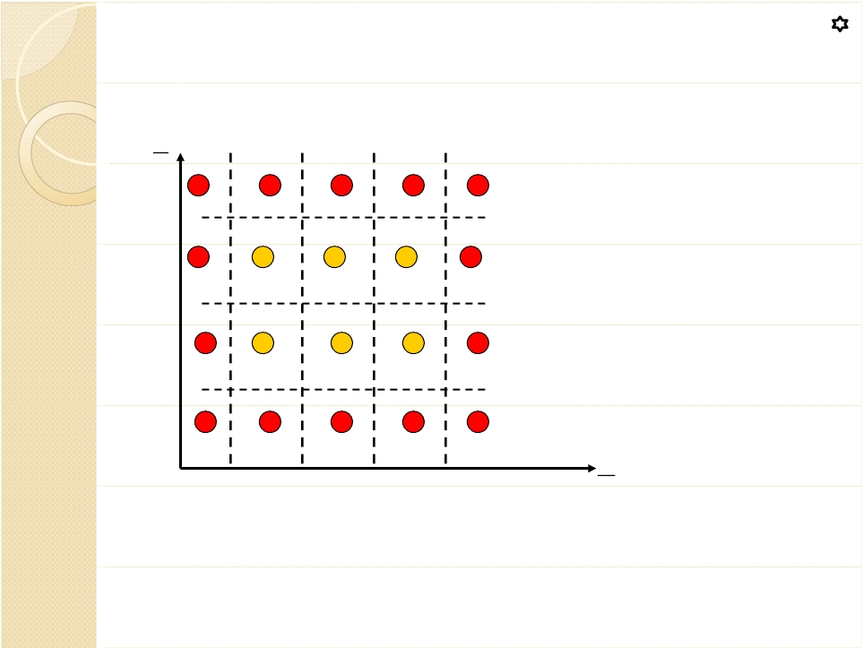
Strong Robust EquivalenceTesting
Y
g
f
e
X
0
a
b
c
d
The robust part comes from consideration of invalid values
The strong part refers to the multiple fault assumption.

Slide 32
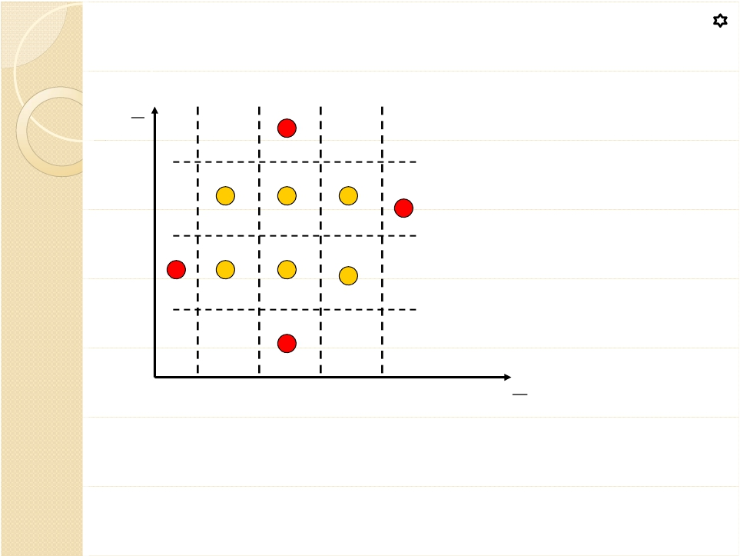
Hybrid approach
Y
g
f
e
0
X
a
b
c
d
Use weak testing for invalid input and strong testing for valid input.
Generate test cases for every combinations of valid ECs (strong testing).
For invalid EC,only combine with one of the valid EC (weak testing).

